Slide 1


Slide 2
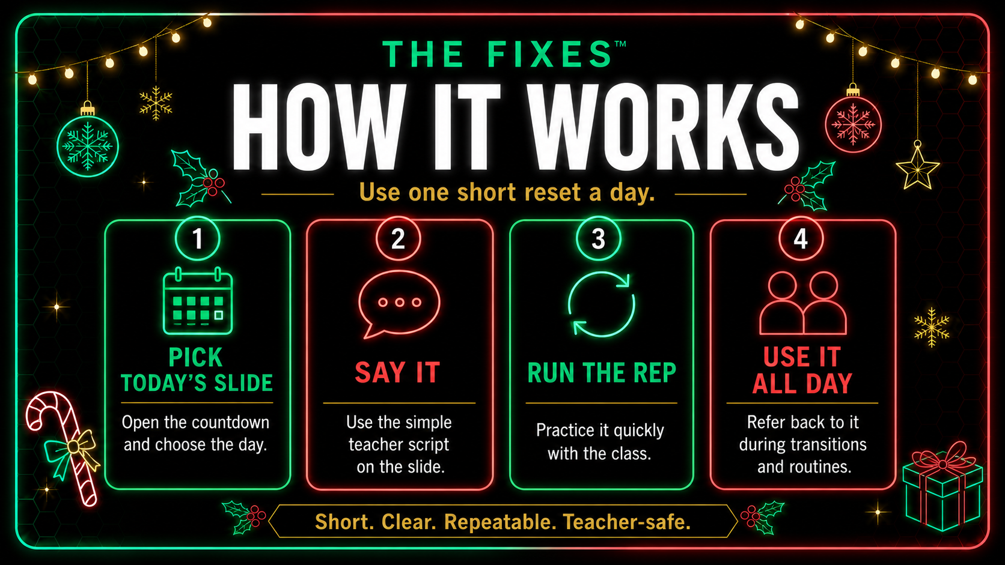

Slide 3
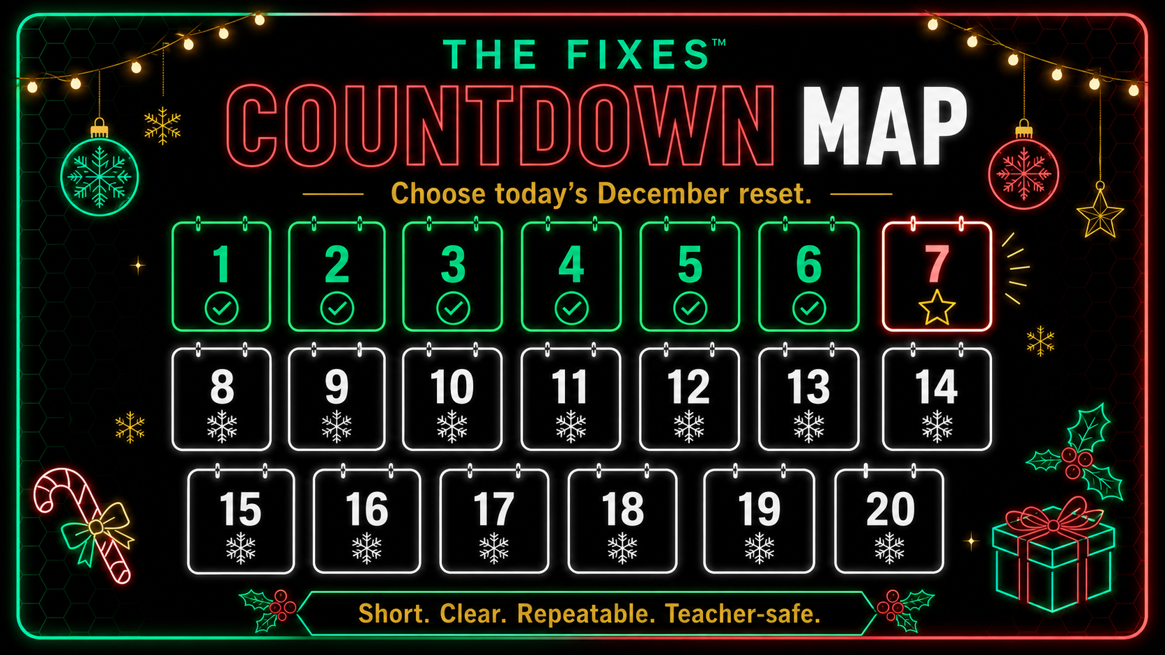

Slide 4
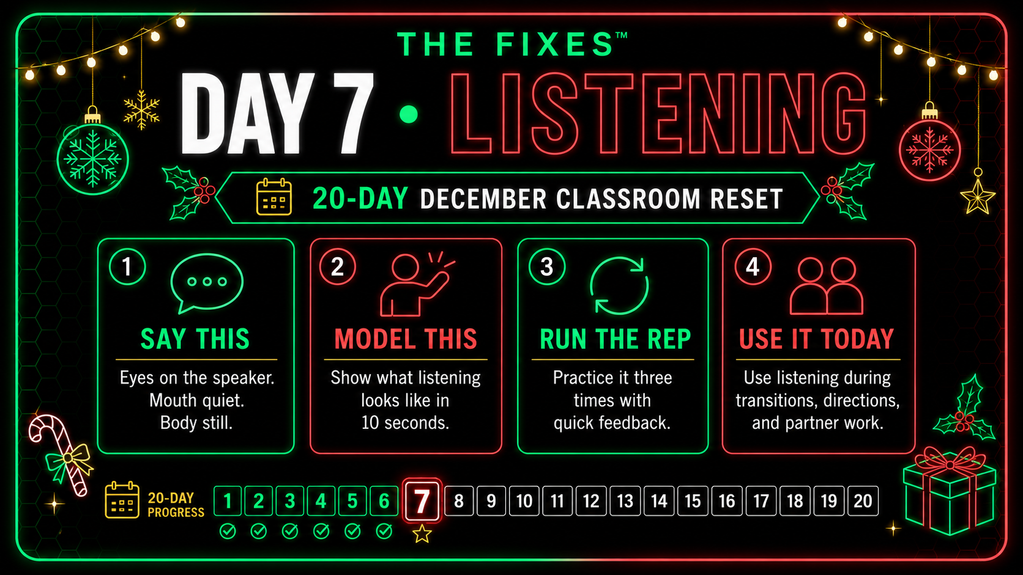

Slide 5
THE FIXES™
DAY 01
LISTENING
Elf Ears On
Eyes up. Ears open. Body calm.
WHY THIS MATTERS
STUDENT PRACTICE
December directions get repeated fast. This Fix helps students hear it once and start cleaner.
Quiet Elf Echo: students repeat one short direction and do it right away.
TEACHER SCRIPT
TROUBLESHOOTING
"Show me your Elf Ears - up, focused, ready."
Reset posture with one slow breath and rerun the cue.
HOW TO RUN IT
HOME CONNECTION
Model calm listening posture. Show a silly not-yet version. Students mirror the clean version for five seconds.
Show Elf Ears to someone at home.
Short. Clear. Repeatable. Teacher-safe.

Slide 6
THE FIXES™
DAY 02
LINE ROUTINE
Sleigh Line Level-Up
Smooth. Quiet. Steady.
WHY THIS MATTERS
STUDENT PRACTICE
December lines can turn into parade energy. This makes the hallway routine visible and repeatable.
Silent Sleigh Walk: walk, stop, reset, and repeat cleaner.
TEACHER SCRIPT
TROUBLESHOOTING
"We move like Santa's sleigh - smooth, quiet, steady."
Rushing means redo only that section - no lecture.
HOW TO RUN IT
HOME CONNECTION
Model the hallway walk in a ten-step stretch. Fix only the section that broke.
Practice calm walking from one room to another.
Short. Clear. Repeatable. Teacher-safe.

Slide 7
THE FIXES™
DAY 03
POLITE GREETING
Greet Like Guests
Kind eyes. Calm voice. Friendly hello.
WHY THIS MATTERS
STUDENT PRACTICE
December guests, assemblies, and visitors create real chances to practice polite confidence.
Greet three people in class using the phrase.
TEACHER SCRIPT
TROUBLESHOOTING
"Greet like holiday hosts - kind eyes, calm voices, friendly hello."
Use sentence frames for students who freeze.
HOW TO RUN IT
HOME CONNECTION
Model three greetings: too silly, too quiet, and just right.
Greet someone politely at home.
Short. Clear. Repeatable. Teacher-safe.

Slide 8
THE FIXES™
DAY 04
TECH FOCUS
One-Tab Workshop
One tab. One task. Full focus.
WHY THIS MATTERS
STUDENT PRACTICE
December tech work gets messy when students bounce between tabs. This gives them one clean move.
Three-minute focus sprint with one tab open.
TEACHER SCRIPT
TROUBLESHOOTING
"One tab open means holiday focus mode."
Distracted? Close everything and reopen the one needed tab.
HOW TO RUN IT
HOME CONNECTION
Show a chaotic screen and a focused screen. Students close everything except the task.
Try one-tab homework or reading time.
Short. Clear. Repeatable. Teacher-safe.

Slide 9
THE FIXES™
DAY 05
REDO / GRIT
Snowball Try-Again
Miss it. Fix it. Try again.
WHY THIS MATTERS
STUDENT PRACTICE
A redo is not failure. It is how December routines stay calm when mistakes happen.
Redo one classroom move: lining up, handing in work, or starting quietly.
TEACHER SCRIPT
TROUBLESHOOTING
"If your snowball breaks, you make a new one."
Break the task smaller and rerun one part.
HOW TO RUN IT
HOME CONNECTION
Model a tiny mistake, pause, and calmly redo it.
Share one try-again moment at home.
Short. Clear. Repeatable. Teacher-safe.

Slide 10
THE FIXES™
DAY 06
CALM BODY
Cozy Cabin Mode
Slow breath. Soft hands. Calm body.
WHY THIS MATTERS
STUDENT PRACTICE
Holiday excitement is real. Cozy Cabin Mode teaches students how to downshift without shame.
Three-minute calm task in Cozy Cabin Mode.
TEACHER SCRIPT
TROUBLESHOOTING
"We switch into Cozy Cabin Mode - calm, quiet, focused."
Reset with slow hands and a quiet countdown.
HOW TO RUN IT
HOME CONNECTION
Model a breath, softer movement, and a quieter voice.
Use Cozy Mode during bedtime reading or quiet time.
Short. Clear. Repeatable. Teacher-safe.

Slide 11
THE FIXES™
DAY 07
RESPECT
Respect Reset
Kind words. Kind face. Try again.
WHY THIS MATTERS
STUDENT PRACTICE
December tension shows up as sarcasm, eye rolls, and side comments. This gives a reset phrase.
Practice respectful responses to three small scenarios.
TEACHER SCRIPT
TROUBLESHOOTING
"Respect resets the whole room."
If sarcasm shows up, pause and rerun the exact sentence.
HOW TO RUN IT
HOME CONNECTION
Model an eye-roll, then reset it with a kind nod and clean words.
Catch someone being kind and say thanks.
Short. Clear. Repeatable. Teacher-safe.

Slide 12
THE FIXES™
DAY 08
CLEAN-UP ROUTINE
Workshop Cleanup Crew
Fast hands. Quiet voices. Finished space.
WHY THIS MATTERS
STUDENT PRACTICE
Holiday projects make messes. A clean-up system keeps the room from ending in chaos.
Clean-up race: beat the timer without losing the calm.
TEACHER SCRIPT
TROUBLESHOOTING
"We clean up like a pro crew - fast and focused."
Missed corners? Redo that section only.
HOW TO RUN IT
HOME CONNECTION
Assign jobs. Show what finished looks like. Start the timer.
Clean up one home space without being asked.
Short. Clear. Repeatable. Teacher-safe.

Slide 13
THE FIXES™
DAY 09
DIRECTIONS
Two-Step Test
Hear both. Do both. In order.
WHY THIS MATTERS
STUDENT PRACTICE
Students often hear the first step and drop the second. This trains follow-through.
Call out two-step combos. Students act them out silently.
TEACHER SCRIPT
TROUBLESHOOTING
"We listen for both steps and do them in order."
Confusion means repeat it back, then do it.
HOW TO RUN IT
HOME CONNECTION
Model a two-step direction. Students repeat both steps before moving.
Complete one two-step chore at home.
Short. Clear. Repeatable. Teacher-safe.

Slide 14
THE FIXES™
DAY 10
KINDNESS
Kindness Inside the Classroom
Small kindness. Stronger room.
WHY THIS MATTERS
STUDENT PRACTICE
Winter energy can increase conflict. This day turns kindness into a practice, not a poster.
Kindness Bingo: complete three kind actions before lunch.
TEACHER SCRIPT
TROUBLESHOOTING
"Kindness is how we stay strong together."
Redirect teasing with: reset the sentence.
HOW TO RUN IT
HOME CONNECTION
Name three small kind acts students can actually do today.
Do one kind action for a sibling, pet, or parent.
Short. Clear. Repeatable. Teacher-safe.

Slide 15
THE FIXES™
DAY 11
ENTRY ROUTINE
Perfect Entry Challenge
Enter calm. Start ready.
WHY THIS MATTERS
STUDENT PRACTICE
The first two minutes can decide the next thirty. This makes entry a practiced routine.
Walk in, reset, and walk in again cleaner.
TEACHER SCRIPT
TROUBLESHOOTING
"Let's show the world what perfect entry looks like."
Rushing or yelling means redo the entry loop.
HOW TO RUN IT
HOME CONNECTION
Model entry: calm steps, quiet voice, materials ready.
Practice a calm morning entrance at home.
Short. Clear. Repeatable. Teacher-safe.

Slide 16
THE FIXES™
DAY 12
QUIET START
Silent Start
Start silent like snowfall.
WHY THIS MATTERS
STUDENT PRACTICE
December mornings get noisy. A silent start protects the first minutes of learning.
Three-minute Silent Start challenge.
TEACHER SCRIPT
TROUBLESHOOTING
"Start silent like snowfall."
Reset the moment it gets loud. Restart the timer.
HOW TO RUN IT
HOME CONNECTION
Choose a quiet entry routine: read, draw, organize, or prepare materials.
Start the morning quiet for three minutes.
Short. Clear. Repeatable. Teacher-safe.

Slide 17
THE FIXES™
DAY 13
REDO / RESILIENCE
Try Again Challenge
Every Fix gets a retry.
WHY THIS MATTERS
STUDENT PRACTICE
Mistakes happen more when everyone is tired. This normalizes the clean redo.
Try Again Race: silently redo a routine or task.
TEACHER SCRIPT
TROUBLESHOOTING
"Every Fix deserves a retry."
If redo is rushed, model a slower version.
HOW TO RUN IT
HOME CONNECTION
Model a mistake, pause, and try again calmly.
Share one thing you tried again at home.
Short. Clear. Repeatable. Teacher-safe.

Slide 18
THE FIXES™
DAY 14
TASK COMPLETION
Mini Project Finish
Finish small. Finish strong.
WHY THIS MATTERS
STUDENT PRACTICE
December creates a trail of unfinished tasks. This builds completion before break.
Mini Finish Festival: ten minutes to wrap one thing up.
TEACHER SCRIPT
TROUBLESHOOTING
"Finish strong before the break."
Support stuck students with the next tiny step.
HOW TO RUN IT
HOME CONNECTION
Pick one tiny unfinished job and show what done looks like.
Finish one thing at home that has been left undone.
Short. Clear. Repeatable. Teacher-safe.

Slide 19
THE FIXES™
DAY 15
VOICE VOLUME
Calm Caroling
Heart in it. Volume under control.
WHY THIS MATTERS
STUDENT PRACTICE
Songs, assemblies, and celebrations can go loud fast. This keeps joy without chaos.
Calm Carol Challenge: hum or sing softly together.
TEACHER SCRIPT
TROUBLESHOOTING
"We sing with heart - not chaos."
If volume spikes, pause and restart with a quieter target.
HOW TO RUN IT
HOME CONNECTION
Model calm singing, then wild yelling. Compare the difference.
Sing or hum quietly to someone at home.
Short. Clear. Repeatable. Teacher-safe.

Slide 20
THE FIXES™
DAY 16
KIND WORDS
Compliment Drop
Notice good. Say it clean.
WHY THIS MATTERS
STUDENT PRACTICE
Compliments shift the room from tension to connection when December gets tight.
Compliment Relay: give three specific compliments.
TEACHER SCRIPT
TROUBLESHOOTING
"Drop a compliment like a gift."
Use a frame: I noticed you ___ and it helped because ___.
HOW TO RUN IT
HOME CONNECTION
Model a specific compliment, not a generic one.
Drop one specific compliment at home.
Short. Clear. Repeatable. Teacher-safe.

Slide 21
THE FIXES™
DAY 17
FOLLOW-THROUGH
Follow-Through Gift-Wrap
Start strong. Finish stronger.
WHY THIS MATTERS
STUDENT PRACTICE
Students often stop at almost done. This Fix makes the last step matter.
Follow-Through Race: complete one task from start to finish.
TEACHER SCRIPT
TROUBLESHOOTING
"Start strong, finish stronger."
Use a checklist before anyone says done.
HOW TO RUN IT
HOME CONNECTION
Model an unfinished job, then finish the final detail.
Wrap up one chore fully.
Short. Clear. Repeatable. Teacher-safe.

Slide 22
THE FIXES™
DAY 18
COMMUNITY MANNERS
Door Holder Dash
Hold. Wait. Walk through calm.
WHY THIS MATTERS
STUDENT PRACTICE
Door etiquette fades when excitement rises. This gives students a quick community practice.
Door Holder Drill: three smooth passes in a row.
TEACHER SCRIPT
TROUBLESHOOTING
"We open doors like holiday hosts."
If it gets noisy, reset with silent entry.
HOW TO RUN IT
HOME CONNECTION
Model holding the door, waiting, and passing through calmly.
Hold a door open today - quietly.
Short. Clear. Repeatable. Teacher-safe.

Slide 23
THE FIXES™
DAY 19
TECH READINESS
Tech Check Sprint
Charge. Check. Fix first.
WHY THIS MATTERS
STUDENT PRACTICE
Tech fails spike before break. This helps students solve one small problem before it derails them.
Tech Sprint: sixty seconds to fix one issue.
TEACHER SCRIPT
TROUBLESHOOTING
"Fix it before it breaks."
Glitch? Use a buddy coach before calling out.
HOW TO RUN IT
HOME CONNECTION
Run a tech check: charge, restart, log in, close extra tabs.
Check a tablet or laptop at home.
Short. Clear. Repeatable. Teacher-safe.

Slide 24
THE FIXES™
DAY 20
CELEBRATE AND TRANSFER
The Workshop Finale
End calm. End proud. End strong.
WHY THIS MATTERS
STUDENT PRACTICE
The final day should celebrate growth without losing the room.
Final Mission: act out your strongest Fix of the month.
TEACHER SCRIPT
TROUBLESHOOTING
"We end strong, like pros."
Too loud? Freeze Frame reset and try again.
HOW TO RUN IT
HOME CONNECTION
Review three Fixes. Students demonstrate one clean behavior move.
Tell someone your favorite December Fix.
Short. Clear. Repeatable. Teacher-safe.

